Slide 1

Term Deposit Prediction
Name

Slide 2
Agenda
Introduction
Overview of CRISP-DM and the project goal.
Business Understanding
Understanding the context and stakeholders involved.
Data Understanding
Insight into the dataset used for predictions.
Data Preparation
How the dataset was cleaned and prepared for modeling.
Modeling
Algorithms and techniques used for prediction.
Evaluation
Metrics and findings from the modeling phase.
Deployment
How the model will be put into production and maintained.
Conclusion & Next Steps
Summary of findings and future plans.
Q&A
Open floor for questions and discussions.

Slide 3
Introduction
Introduce the CRISP-DM framework as the backbone of this Data Science project.
Explain that the goal is to predict bank deposits, a crucial business metric.
Outline why accurate deposit prediction is vital for the bank's revenue and customer relationship management.

Slide 4
Business Understanding
Objective: Increase the bank's revenue by targeting potential depositors.
Stakeholders: Bank executives, marketing team, data scientists.
Success Criteria: Achieve at least 85% accuracy in deposit prediction.

Slide 5
Data Understanding
Data Source: Internal bank records.
Features include customer demographics, loan status, and past interactions.
Highlight: No missing values but some features like 'balance' are highly skewed.

Slide 6
EDA

Slide 7
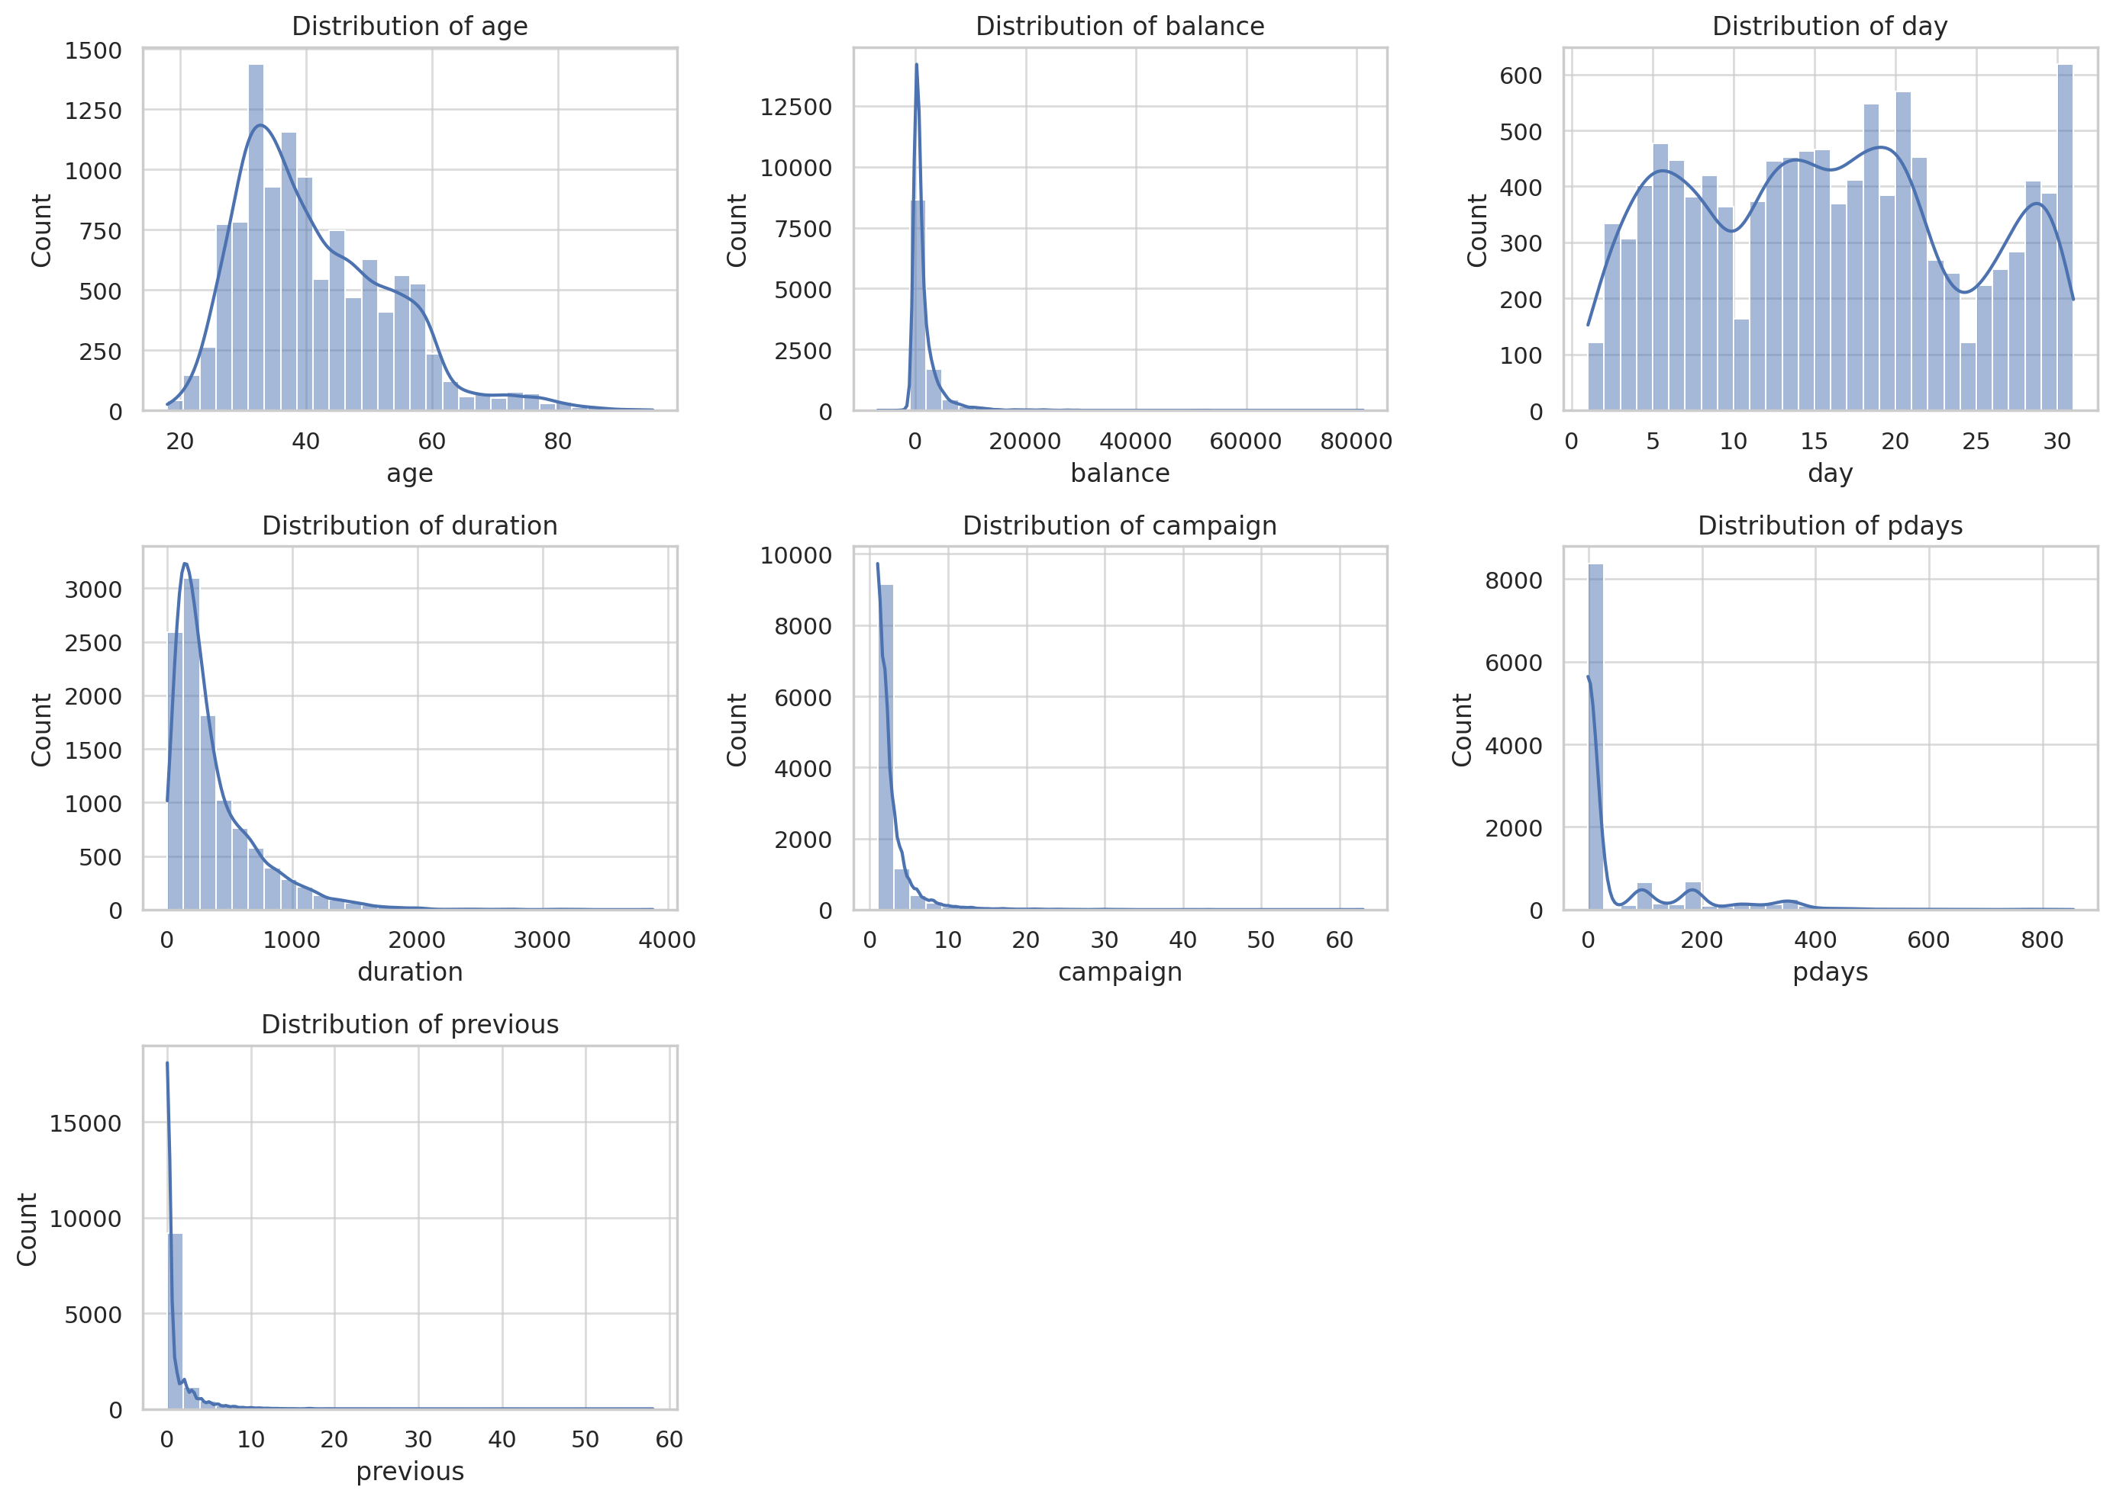
Numerical features

Slide 8
Distribution of Numerical Features
Age: The age distribution appears to be slightly right-skewed, with most clients in their 30s and 40s.
Balance: The balance feature is heavily right-skewed, indicating that most clients have a low balance.
Day: The distribution of the day feature is somewhat uniform but has spikes, likely corresponding to specific days of the month where more activity occurs.
Duration: The duration of the last contact is right-skewed, with most lasting a few minutes.
Campaign: The number of contacts performed during this campaign is also right-skewed, with most clients being contacted only a few times.
Pdays: The distribution indicates that a large number of clients were not previously contacted.
Previous: Like pdays, the previous feature is right-skewed, indicating that most clients have zero or very few contacts before the campaign.

Slide 9
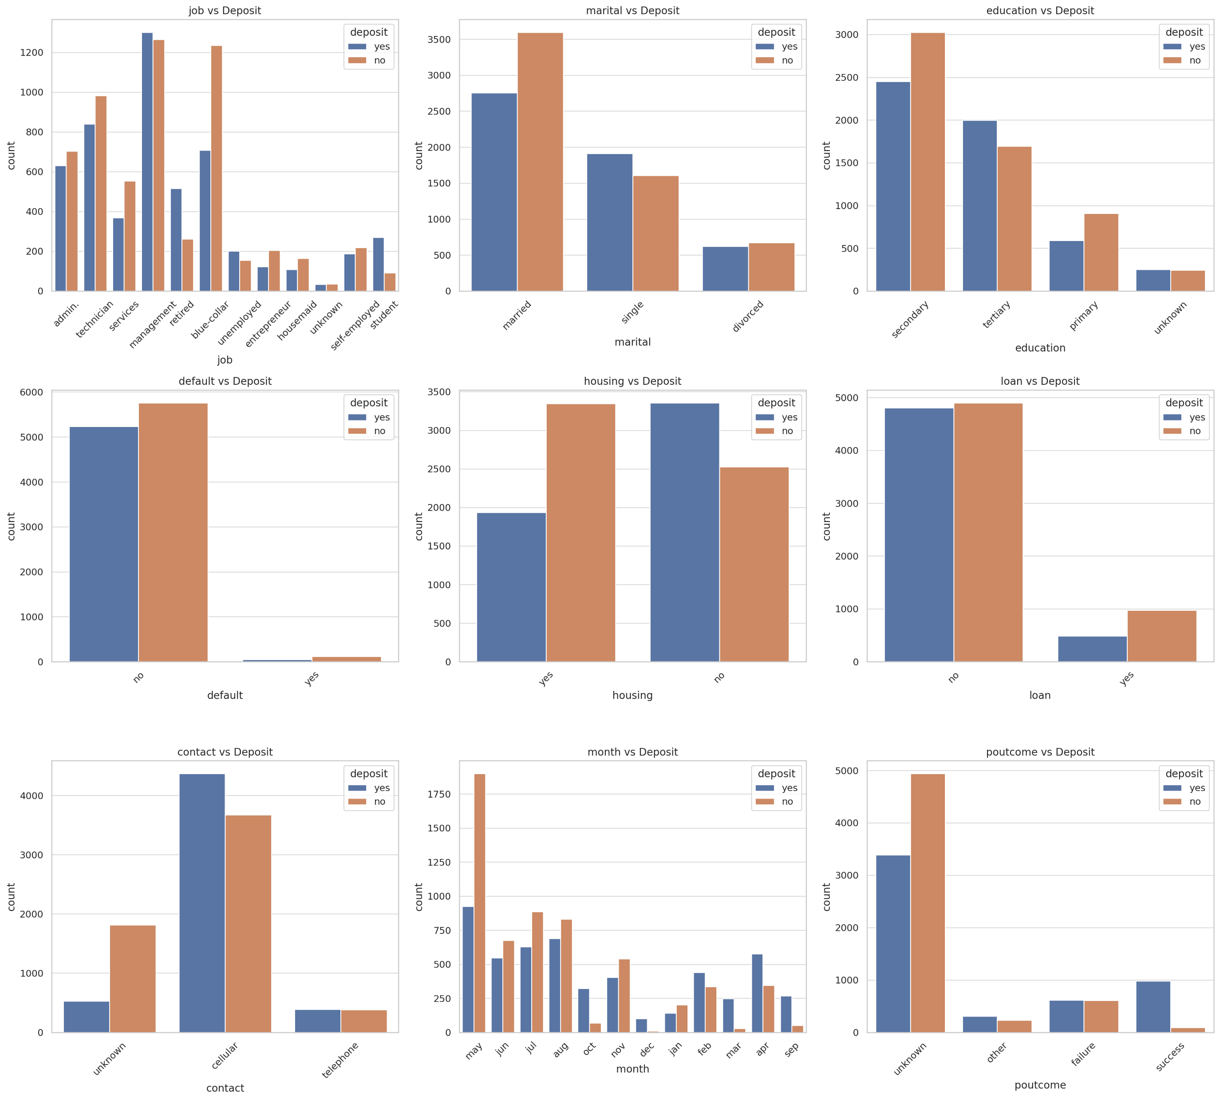
Categorical features

Slide 10
Distribution of Categorical Features vs Deposit
Job: Different job types show varying levels of deposits. For example, students and retired individuals seem to have a higher proportion of "yes" for deposits.
Marital: The marital status does not show a strong differentiation in deposit behavior.
Education: Clients with tertiary education seem to have a higher tendency to deposit.
Default: Clients with no credit default have a higher proportion of deposits.
Housing: Clients without housing loans are more likely to deposit.
Loan: Clients without personal loans are more likely to deposit.
Contact: The unknown contact type has a higher proportion of "no" for deposits.
Month: The month of last contact shows variation in deposit behavior. For example, the months of March, December, September, and October have higher proportions of "yes" for deposits.
Poutcome: Clients with a previous marketing campaign outcome of success have a higher proportion of deposits.

Slide 11
Data Preparation
Cleaned the data, no missing values were found.
Transformed numerical columns using StandardScaler.
Split the dataset into an 80-20 ratio for training and testing, stratified based on the target variable.

Slide 12
Modeling
Algorithms: Focused on Random Forest Classifier.
Evaluation Metrics: Accuracy, Precision, Recall.
Overfitting: Initial model showed signs of overfitting, requiring hyperparameter tuning.

Slide 13
Evaluation
Achieved an initial test accuracy of 86%.
Random Forest showed signs of overfitting, indicating the need for model refinement.
Model limitations include the risk of overfitting and not accounting for temporal factors.

Slide 14
Deployment
The model will be integrated into the bank’s customer relationship management system.
A quarterly review is planned for model performance.
Real-time monitoring will be established to track the model's predictions.

Slide 15
Conclusion & Next Steps
The Random Forest model shows promise but needs tuning.
Next steps include hyperparameter tuning and possibly trying ensemble methods.
Thank the audience and invite questions related to model improvement or business applications.

Slide 16
Code Link
EDA : https://www.kaggle.com/funxexcel/p1-term-deposit-eda
Model : https://www.kaggle.com/funxexcel/p2-predict-term-deposit

